Slide 1



MODELLING LEGISLATION AS A GRAPH IN THE OTF PROSE OBJECT MODEL AND BLOCKCHAINS
James Hazard
Founder – CommonAccord.org
The intersection of Contract, Legislation and Ontologies

Slide 2
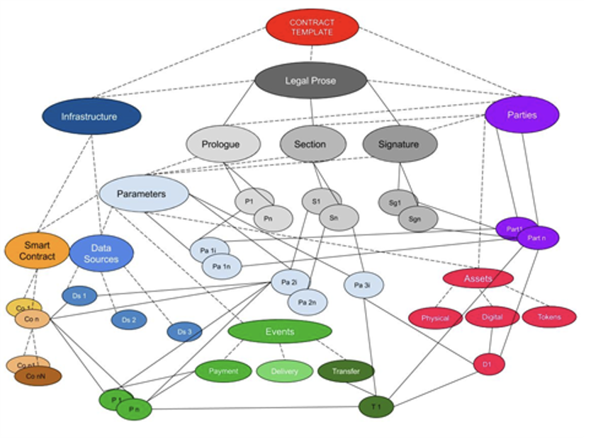
CONTRACTS:
Tomorrow, you’ll hear from Sally Guyer and Luigi Telesca about the Open Trust Fabric and the EU’s “Modelling the EU Economy as an Ecosystem of Contracts”
I will introduce Prose Objects
IAMAL – (merely a lawyer)
We start from the observation that “contracts” can be expressed as nodes of deal specifics that reference nodes for the parties, form of document and other relevant entities
If we write this way, then the contract information remains structured as a graph
MODELLING LAWS IN THE CONTEXT OF CONTRACTS
Notes:
Similarly, the parts of documents can be expressed as nodes, as can the steps in a transaction, each node referencing the prior one.

Slide 3
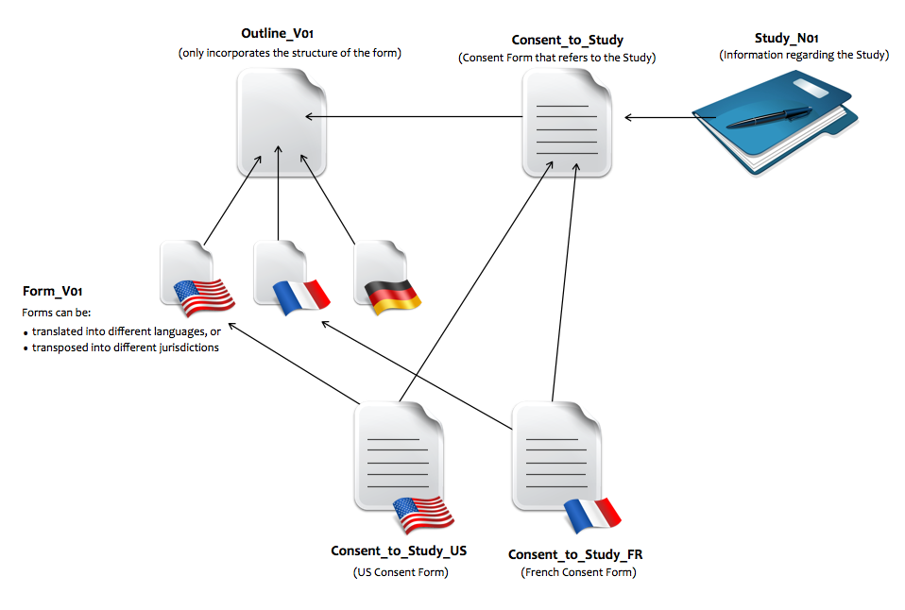
RELATIONSHIPS:
Relationships can be expressed as objects
Patient Consent
Global Alliance for Genomics and Health (GA4GH) model form
MODELLING LAWS IN THE CONTEXT OF CONTRACTS
Notes:
Global Alliance for Genomics and Health model patient consent – a common frame, language modules, an object for the study details, instantiation of particular consents. http://www.commonaccord.org/index.php?action=list&file=G/GA4GH/Demo/

Slide 4
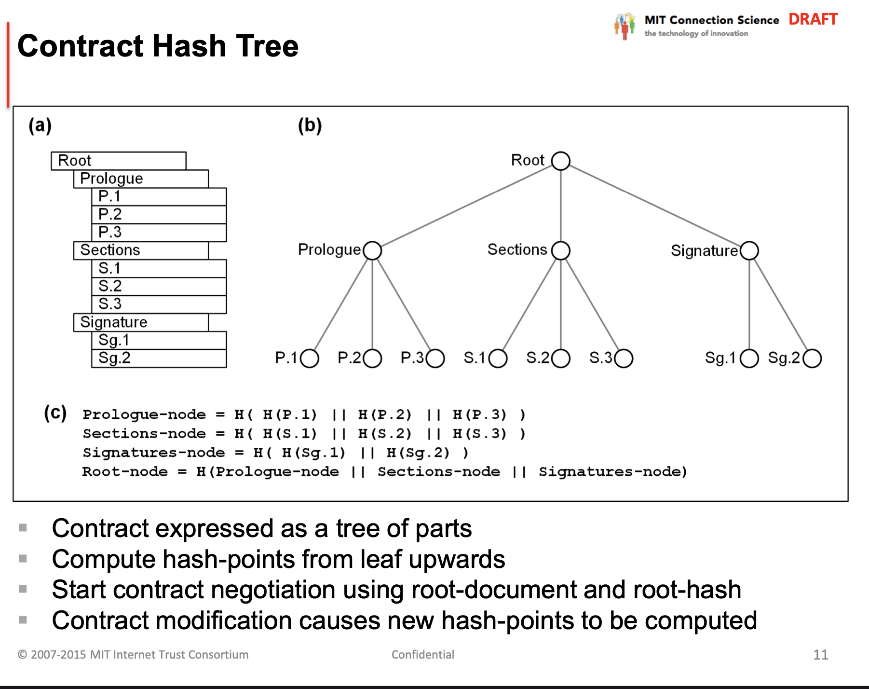
PROSE OBJECTS:
The “Prose Object” data format is a very simple semantic web model for documents
Prose Objects are unitary and composable with other functions and objects
They are composable and malleable via inclusion and overriding
They are compatible with smart contracts, blockchains, and ontologies
MODELLING LAWS IN THE CONTEXT OF CONTRACTS
Notes:
Prose Objects are being developed in connection with the OpenTrustFabric.org, part of the EU Commission project on “Modelling the EU Economy as an Ecosystem of Contracts,” DG-JUST, Exrade and the World Contract and Commerce Association and others are participants in the OTF. You’ll hear from Sally Guyer and Luigi Telesca tomorrow about using contracts expressed as Prose Objects to model the EU economy. Mine will be a technical introduction, and invitation to educate me on intersections.

Slide 5
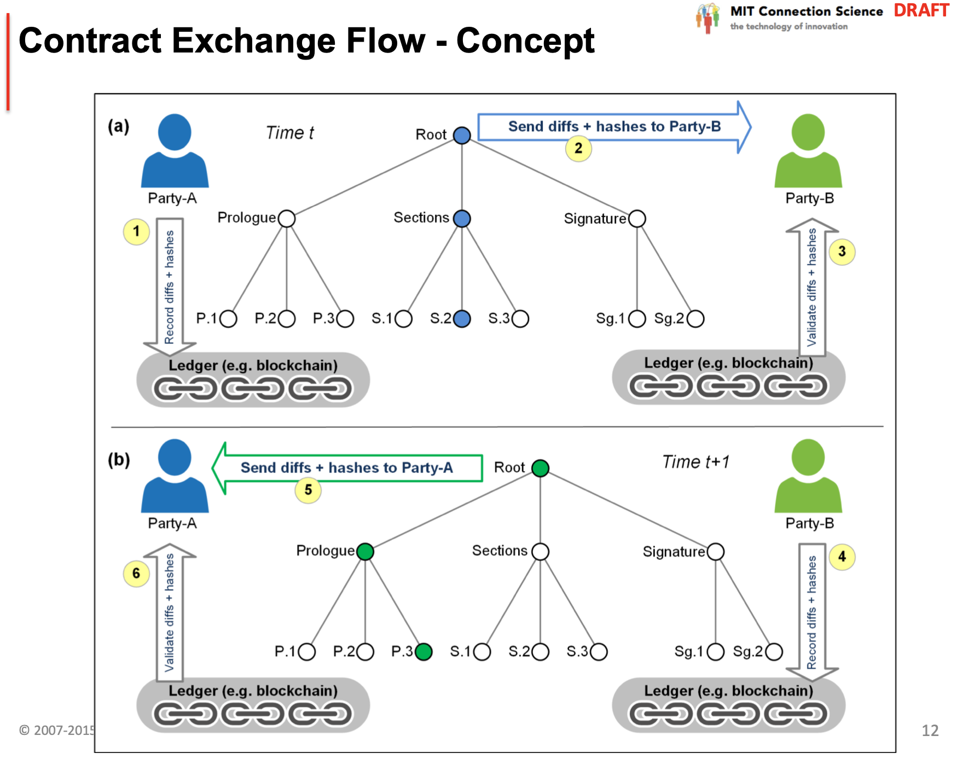
TRANSACTION FLOWS:
Prose Objects linked together can model contract negotiation and performance flows
Each event is treated as a node
A history of a transaction expressed as a graph permits reasoning about impacts and meanings
MODELLING LAWS IN THE CONTEXT OF CONTRACTS

Slide 6
Prose Objects:
A Named Collection of Nodes:
ThisNode:
KeyName=Value as a string with {VariableName} and <ol><li>{1.sec} </li></ol>.
1.sec=<b>HTML Formatting</b>
PrefixName=[OtherNode1]
=[OtherNode2]
Prose Objects are:
Simple in theory
Agnostic in format - in files and emails, git, blockchains, databases, wikis, JSON, XML ...
Composable – and able reference other resources
Malleable - the end user can override or extend every element
MODELLING LAWS IN THE CONTEXT OF CONTRACTS

Slide 7
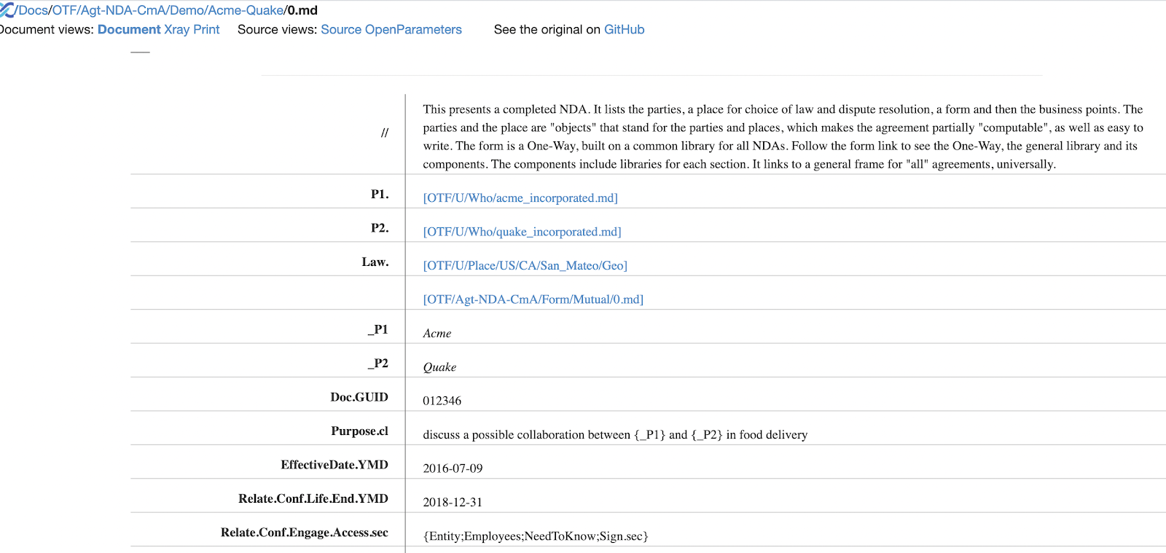
Objectified Agreements:
A contract document ordinarily:
Links to the parties
Links to some environmental factors
Links to a form, parameterized for a use-case
Has parameters
Makes some choices among alternatives
MODELLING LAWS IN THE CONTEXT OF CONTRACTS

Slide 8
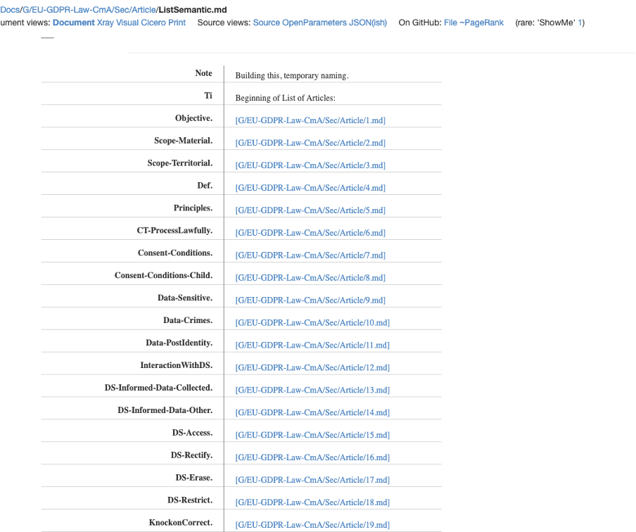
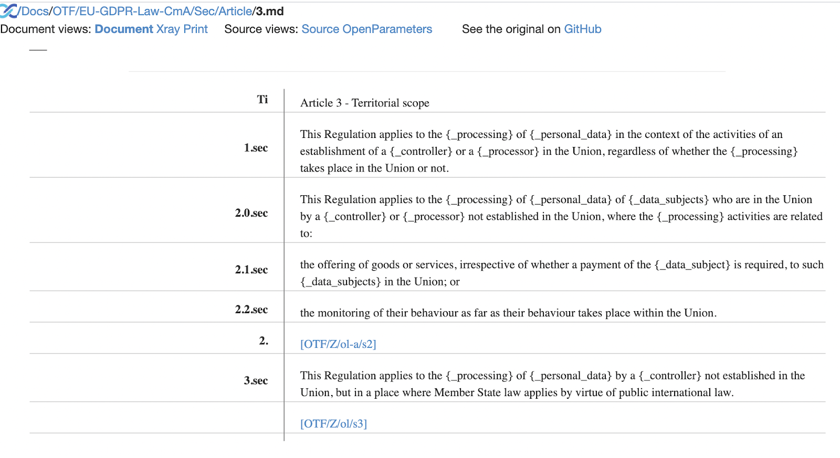
PRIMARY LAW as PROSE OBJECTS - the GDPR:
Legislation and other collective terms can also be expressed as Prose Objects
A contract may include legislative language for convenience or because the law requires it
When reading a contract provision, it is often useful to follow links to the legislation that motivates the provision
This also helps machine learning
MODELLING LAWS IN THE CONTEXT OF CONTRACTS
Notes:
The boundary is soft between party-negotiated “contracts” and collectively decided terms - market rules and “primary law” such as regulations, legislation and court cases. Where the materials are already structured, as with ELI-DL, Akoma-Ntosa - it makes sense to be able to reference them in their native structured form.

Slide 9
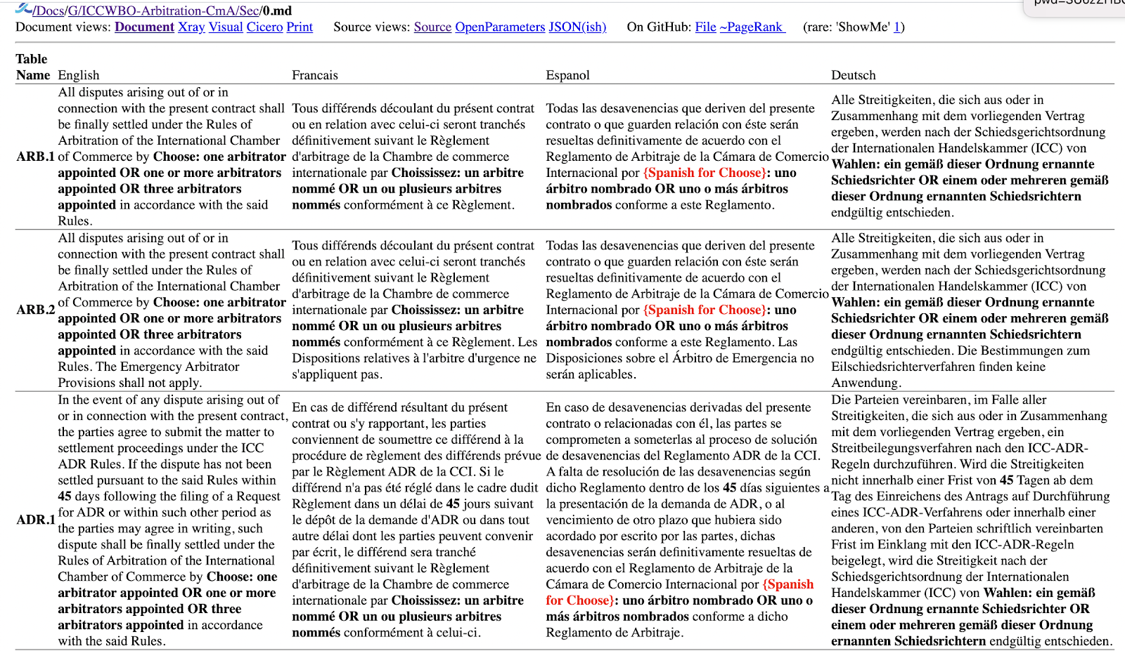
STANDARDS and DISPUTES – ICC ARBITRATION:
Similarly, a contract may give rise to a dispute that needs to be resolved by litigation
If the contract is expressed as Prose Objects, drawing from open models, the adjudicator may be able to cut to the substance of the dispute more quickly.
The rules themselves can also be expressed as Prose Objects
MODELLING LAWS IN THE CONTEXT OF CONTRACTS

Slide 10
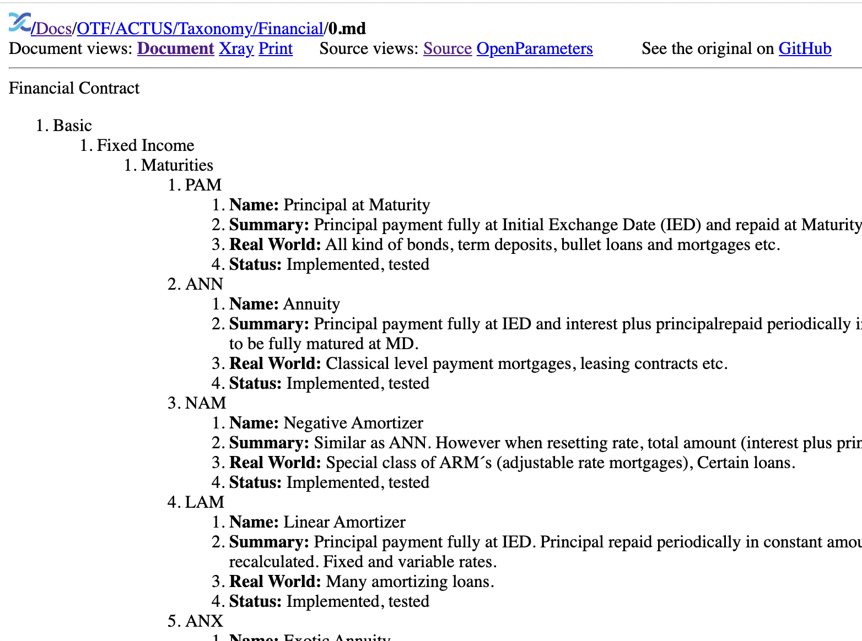
PROSE OBJECTS and ONTOLOGIES:
Contracts are a great vehicle for incremental codification, standardisation and convergence on ontologies
Some powerful ontologies are ready for use
This is an example of an ontology - ACTUS - expressed as Prose Objects
Please tell us about others!
MODELLING LAWS IN THE CONTEXT OF CONTRACTS

Slide 11
NEXT STEPS:
Prose Objects are in their infancy.
a well-developed theory,
a multitude of examples,
support from the OpenTrustFabric.org, the WorldCC and the EU Commission’s “Modelling the EU Economy as an Ecosystem of Contracts.”
aNewGovernance.org is also adopting Prose Objects.
Our ontology is provisional and primitive. The model needs further development along the lines of semantic web.
We welcome connections:
Please see OpenTrustFabric.org to learn more and subscribe, or contact any of us.
James Hazard. james.g.hazard@gmail.com Luigi Telesca luigi@trakti.com Sally Guyer sguyer@worldcc.com Megan Ma megan.ma@sciencespo.fr
MODELLING LAWS IN THE CONTEXT OF CONTRACTS

Slide 12
Modelling legislation as a Graph when using the OTF Prose Object Model, Blockchain and more
James Hazard

